Slide 1

The 5
Hannah Wishon, Umangkumar Patel, Xander Turner, & Michelle Thoi
CISC 225 Information Systems Analysis and Design

Slide 2
Introduction

Slide 3
Information System
Grocery Store Application
Check availability and place orders
Rewards Point System

Slide 4
Roles
Umangkumar
Back- and Front-End Development
Develop order processing algorithms
Xander
Front-End Development
Develop customers’ reward algorithm
Michelle
Back-End Development
Develop and manage customer information database
Hannah
Back-End Development
Develop and Manage Store Inventory database

Slide 5
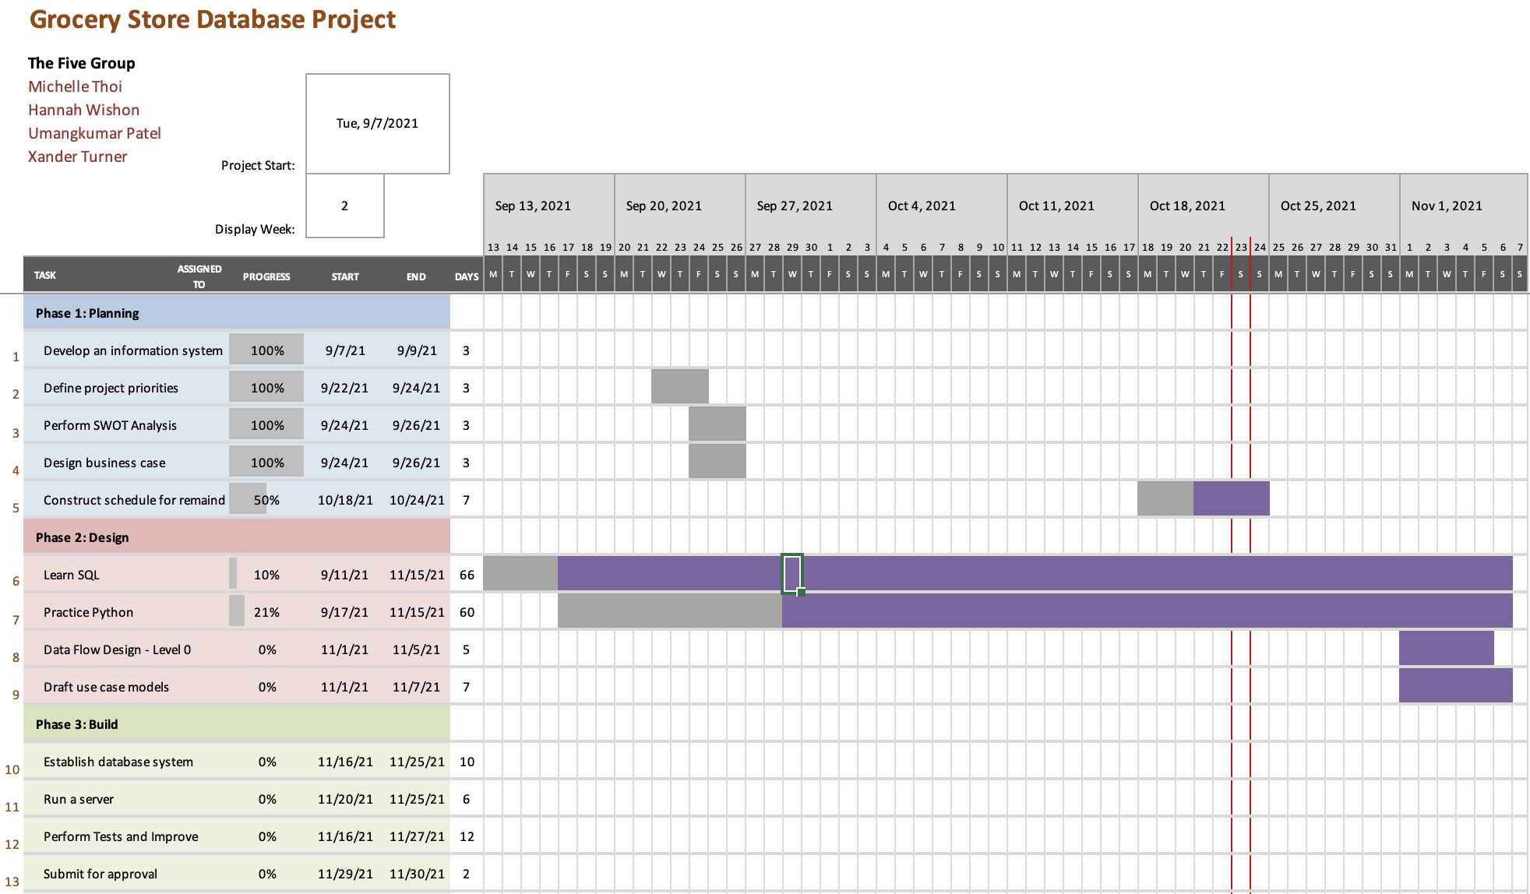
Gantt Chart

Slide 6
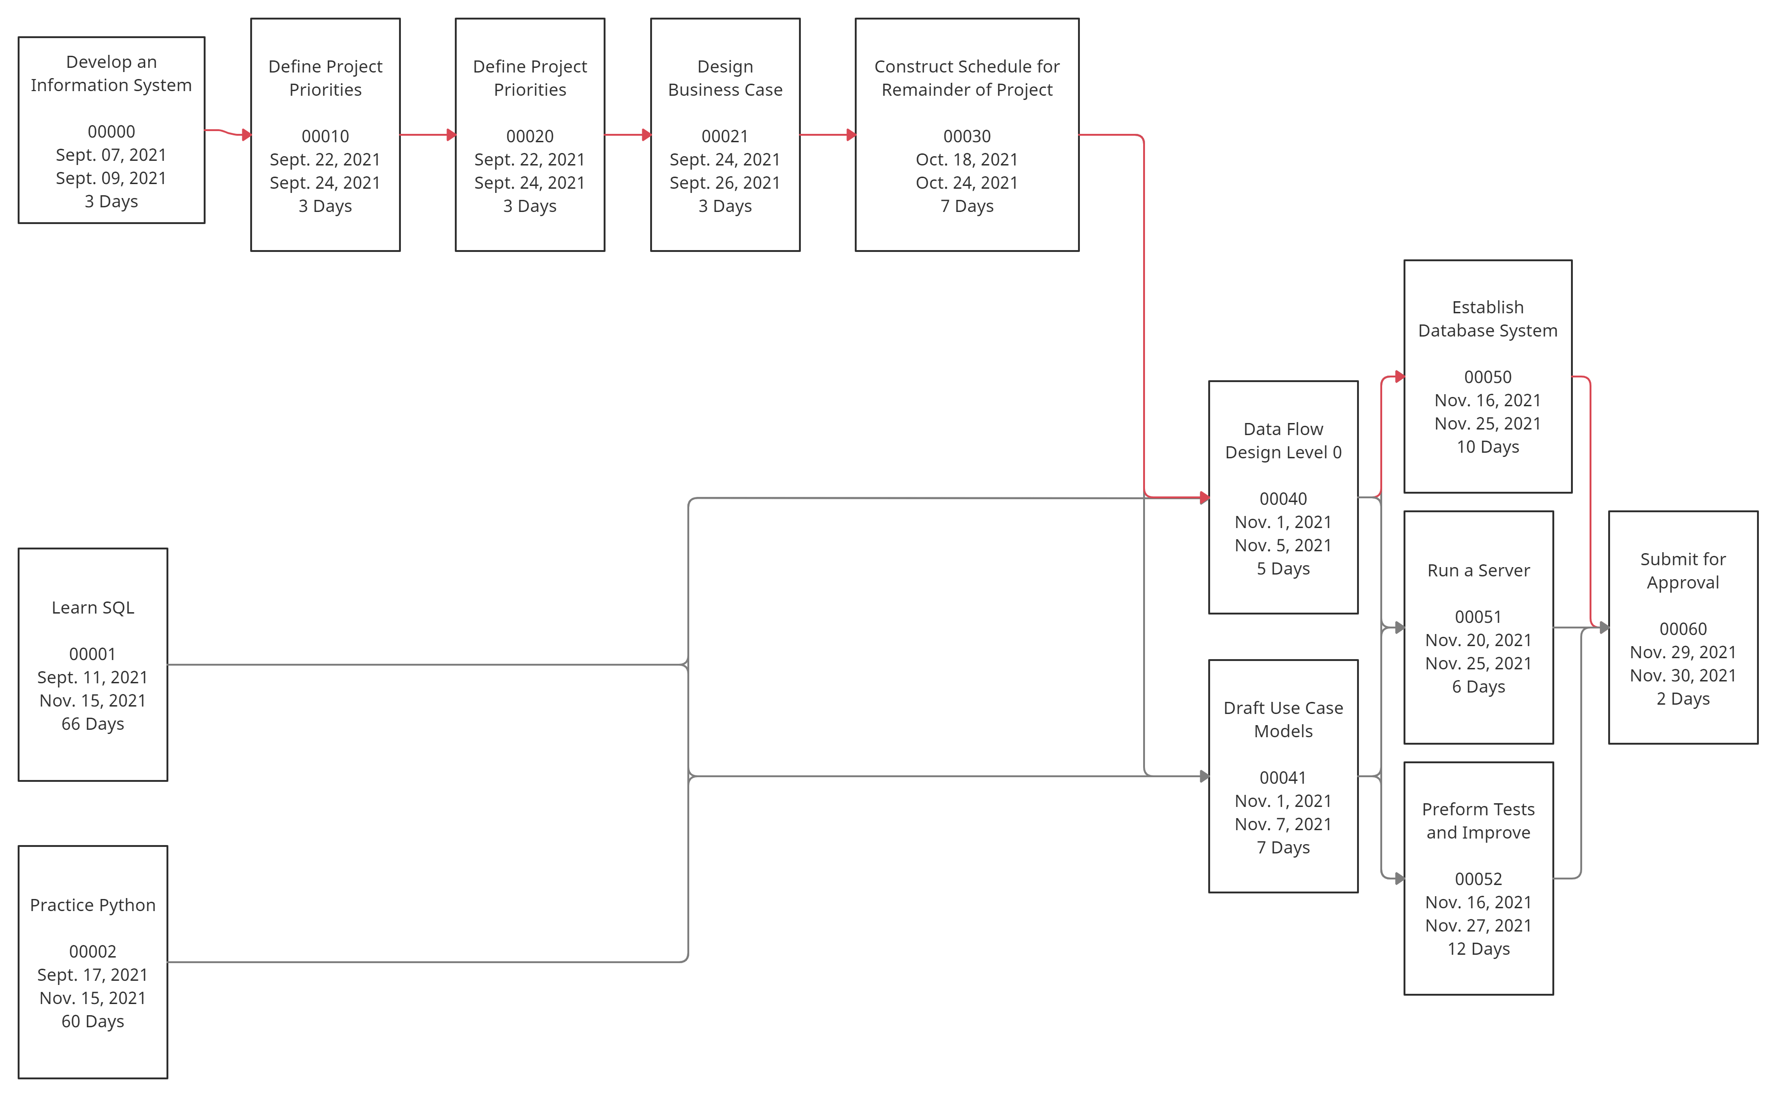
PERT Chart

Slide 7
Use Cases

Slide 8
What data are involved?
Customer
Grocery Store
Name
Store Number/ID
Email
Password
Price
Payment Method
Purchase History
Reward Points
Product ID
Product Name

Slide 9
What does the user do?
Customer
Employee
Create an account / Login
View inventory
Place orders
View Transactions
Login
View customer order
Manage inventory

Slide 10

What are the input use cases (Store)?
Registering a new store account
2. Adding new products
Store
Add a new row to the “Stores” table with the store ID
Add a new row to the “Products” table with the product ID, name, price, and unit

Slide 11
What are the input use cases (Customer)?
Registering an account
2. Update Account Information
Store
3. Adding items to the cart
Add a new row to the “Customers” table and input the customer’s ID, first and last name, email, password, and total rewards
Using the primary key (customer ID), find the row in the “Customers” table and find the column for the information they are changing
Add a new row to the “Line Item” table and input the current transaction ID, product ID, and quantity

Slide 12
What are the output use cases? (Store)
Calculate Customers’ Reward Points
Store
Using the primary key (customer ID), find the row in the “Customers” table and increase the current point total, which is in the Total Rewards column, by adding one point for each dollar they spent in the recent transaction.

Slide 13
What are the output use cases? (Customer)
View Transaction History
2. Check and Use Rewards Points Total
Customer
Using the foreign key (customer ID), return the transaction ID’s for rows in the “Transaction” table that lists the correct customer ID
Using the primary key (customer ID), find the row in the “Customers” table, location the Total Rewards column, and return or change the current number of points

Slide 14
Data Models

Slide 15
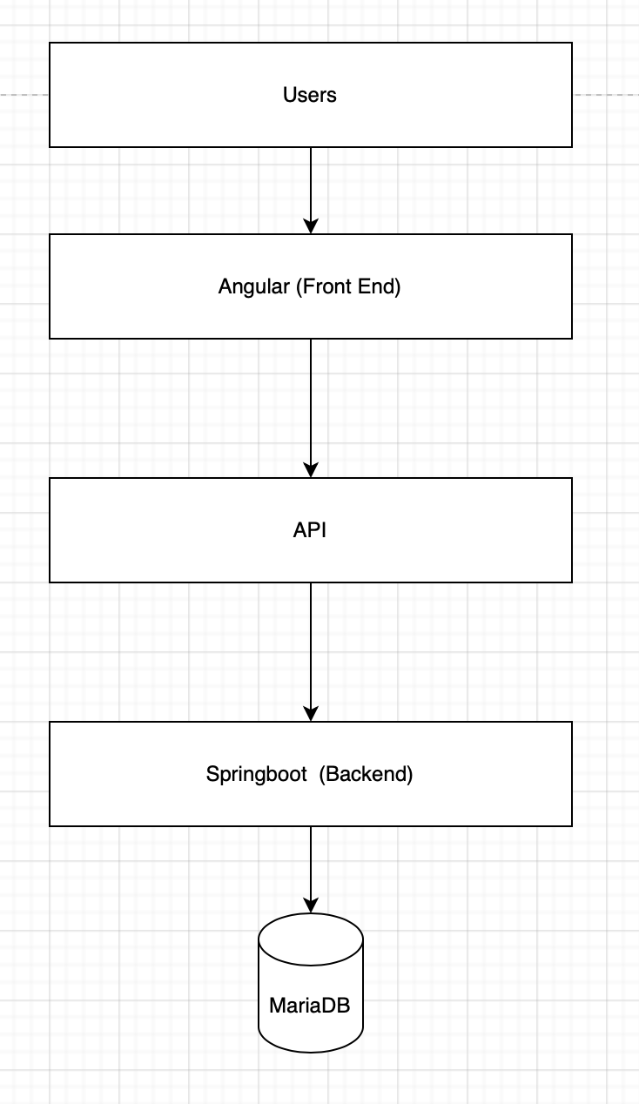
Structure

Slide 16
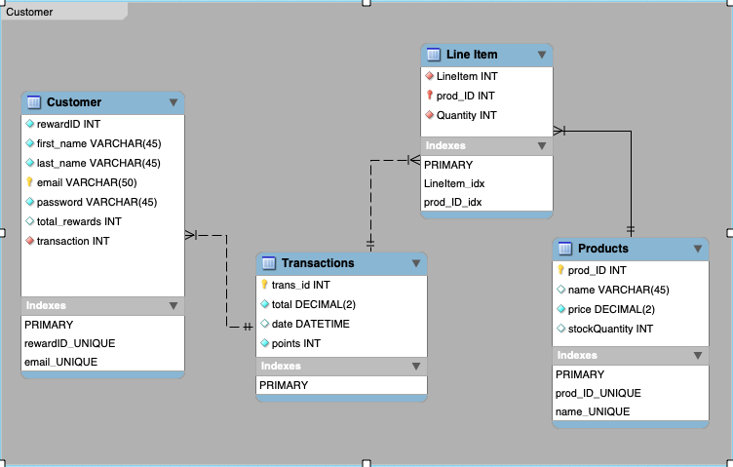
What is the first data model?

Slide 17
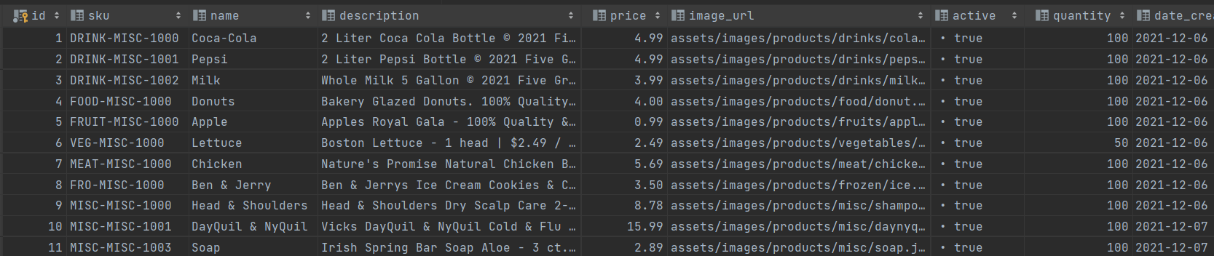
Product Examples

Slide 18
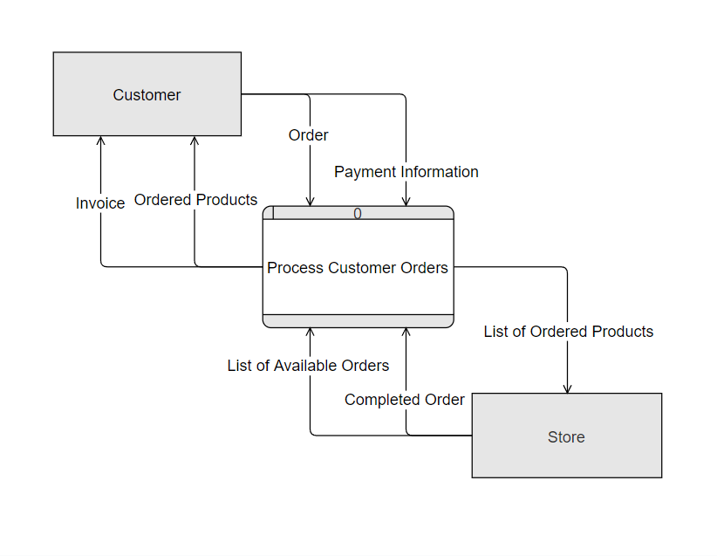
DFD Level 0

Slide 19
Customer Table
Customer ID | First Name | Last Name | Email | Password | Total Rewards
Transaction Table
Customer ID | Transaction ID | Total | Date/Time | Points Earned

Slide 20
Line Item Table
Transaction ID | Product ID | Quantity
Product Table
Product ID | SKU | Product Name | Description | Price | Image URL | Active | Stock Quantity | Date Created | Product Category ID
Product Category Table
Product Category ID | Category Name

Slide 21
User Interface

Slide 22
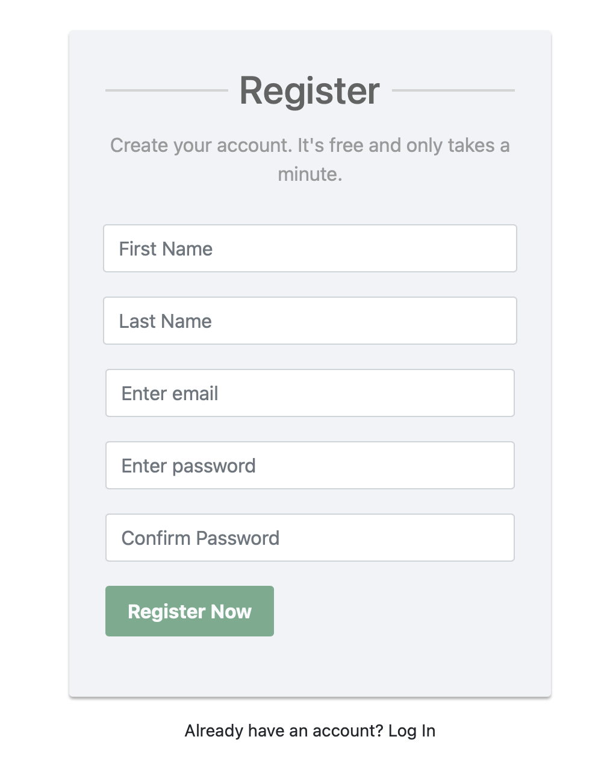
Registration

Slide 23
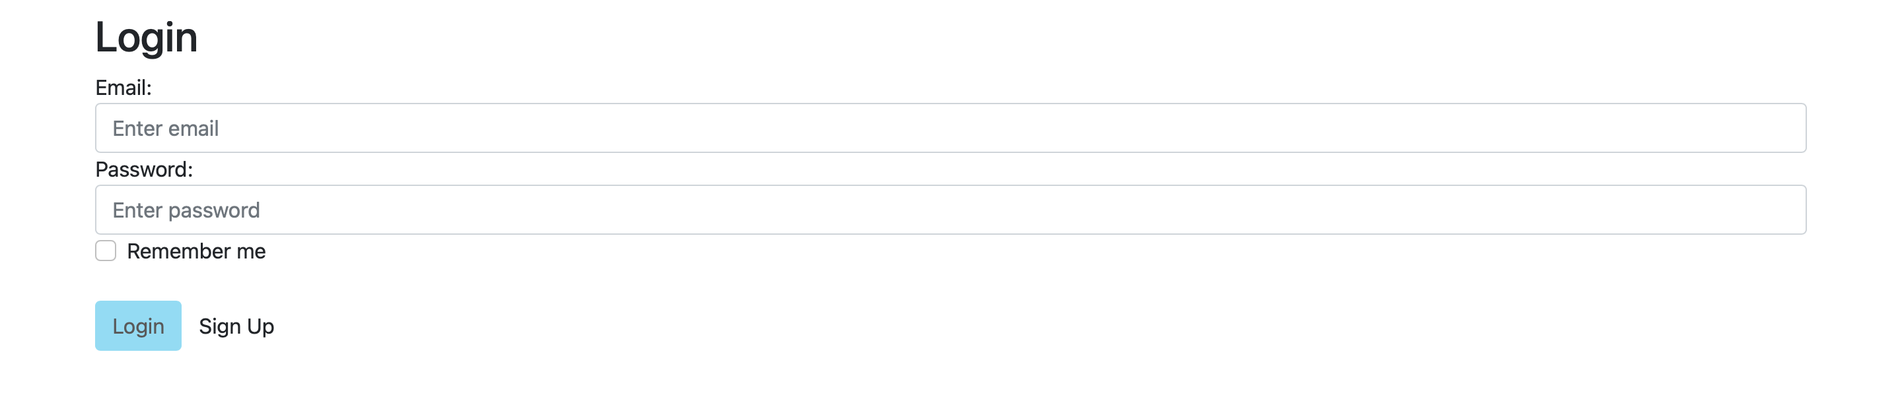
Login

Slide 24
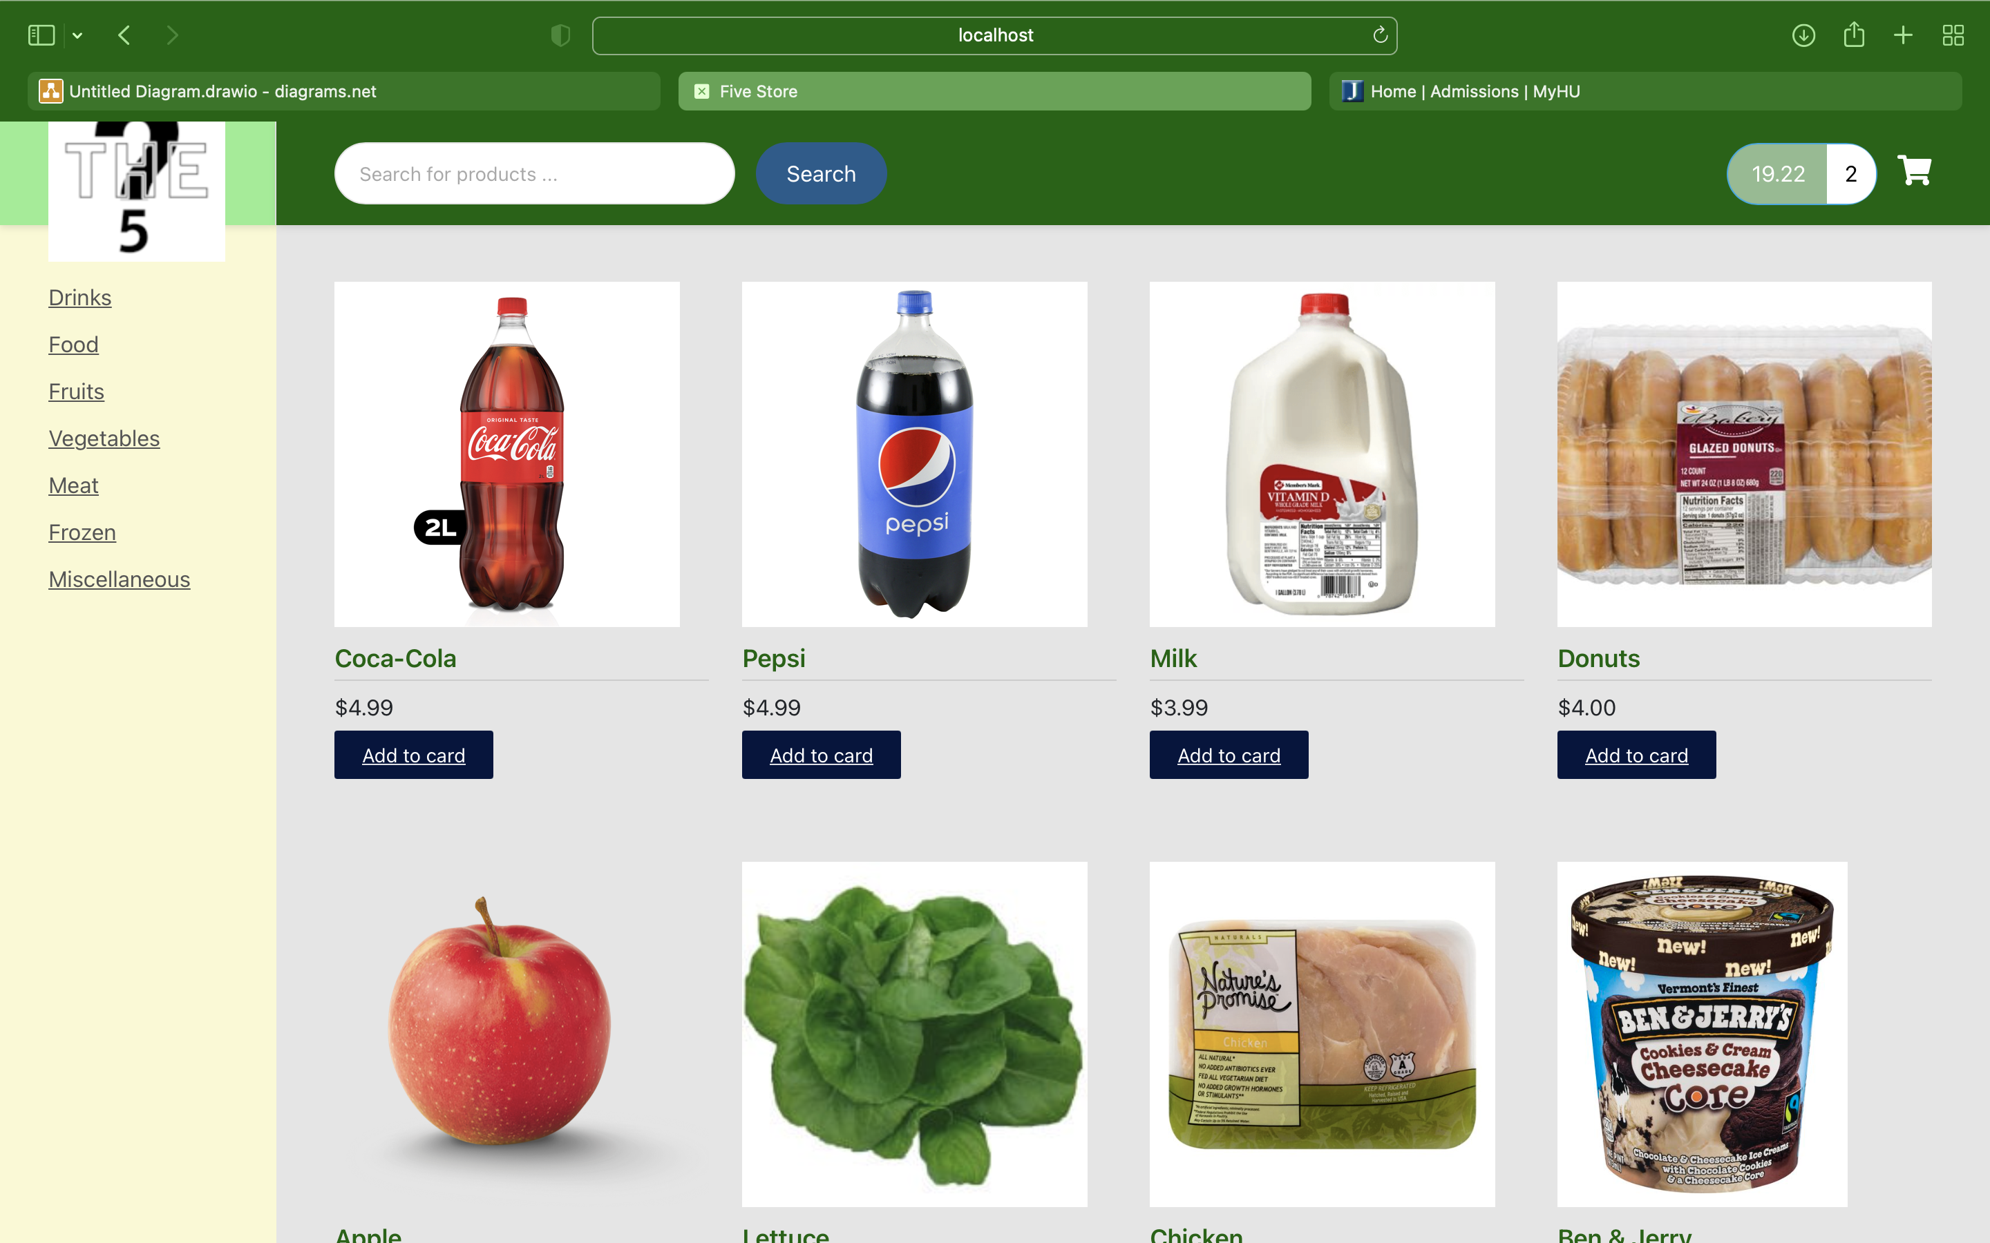
Products Page

Slide 25
Future Scope
Notifies customer when an item is in stock
Provide product recommendations for customers
Report on popular products

Slide 26
Thank you

